Slide 1
INFO6020 – Graphics 2 Week 1, Day 1
Course Intro

Slide 2

Who am I?
Oh my, how convenient is that, I ask you?
Michael Feeney Jr.
G3001
mfeeney@fanshawec.ca
mfeeney@fanshaweonline.ca (slower response)
Office hours: Fridays 9:00 – 12:00 (for now) (or hit me up on discord/e-mail)

Slide 3
What’s this course all about?
This course is a continuation of 'Graphics Level 1' exploring more advanced topics such as: bump mapping, advanced shadow generation, particle and water simulation and rendering, dynamic reflections, blur, bloom, fur and hair simulation, high-dynamic range rendering, and non-graphical programming of GPUs.
INFO-6020 Graphics 2, Winter 2025, mfeeney@fanshawec.ca, Michael Feeney

Slide 4
2024 schedule
Week 1 | Particulate fog and smoke (simple particulate and textured)
Week 2 | Render to off-screen texture
Week 3 | “Deferred rendering”, part 1: Basic full-screen, 2 pass, rendering: Full and partial full screen rendering
Week 4 | Basic full-screen effects: colour filtering, blur, basic depth of field, bloom, etc.
Week 5 | Geometry shader introduction
Week 6 | Decals: texture based: splat, bullet holes. Vertex based: grass, fur, and hair
Week 7 | Mid-term, Project #1
Week 8 | Stencil and scissor buffers
Week 9 | Tessellation shader: basics, LOD, and curve based tessellation (LOD also in Gems) Instanced rendering
Week 10 | Deferred rendering, part 2: Light volumes
Week 11 | Bump/Normal mapping
Week 12 | Bitmap shadows
Week 13 | Compute Shader: non-graphics uses and graphical uses (“Forward+” deferred rendering alternative, etc.)
Week 14 | Additional topics as time permits: Ray tracing (RTX/Vulkan), mesh shaders, HDR (High Dynamic Range), etc.
“Week 15” | Exam week (Game Jam, Final Exam)
INFO-6020 Graphics 2, Winter 2025, mfeeney@fanshawec.ca, Michael Feeney

Slide 5
2024 → 2025
Week 1 | Particulate fog and smoke (simple particulate and textured)
Week 2 | Render to off-screen texture
Week 3 | “Deferred rendering”, part 1: Basic full-screen, 2 pass, rendering: Full and partial full screen rendering
Week 4 | Basic full-screen effects: colour filtering, blur, basic depth of field, bloom, etc.
Week 5 | Geometry shader introduction
Week 6 | Decals: texture based: splat, bullet holes. Vertex based: grass, fur, and hair
Week 7 | Mid-term, Project #1
Week 8 | Stencil and scissor buffers
Week 9 | Tessellation shader: basics, LOD, and curve based tessellation (LOD also in Gems) Instanced rendering
Week 10 | Deferred rendering, part 2: Light volumes
Week 11 | Bump/Normal mapping
Week 12 | Bitmap shadows
Week 13 | Compute Shader: non-graphics uses and graphical uses (“Forward+” deferred rendering alternative, etc.)
Week 14 | Additional topics as time permits: Ray tracing (RTX/Vulkan), mesh shaders, HDR (High Dynamic Range), etc.
“Week 15” | Exam week (Game Jam, Final Exam)
INFO-6020 Graphics 2, Winter 2025, mfeeney@fanshawec.ca, Michael Feeney

Slide 6
Proposed schedule (2025)
Week 1 | Render to off-screen texture (FBO)
Week 2 | Basic full-screen effects: colour filtering, blur, basic depth of field, bloom, etc
Week 3 | “Deferred rendering”, part 1: Basic full-screen, 2 pass, rendering: Full and partial full screen rendering
Week 4 | Particulate fog and smoke (simple particulate and textured)
Week 5 | Geometry shader introduction
Week 6 | Decals: texture based: splat, bullet holes. Vertex based: grass, fur, and hair
Week 7 | Mid-term, Project #1
Week 8 | Stencil and scissor buffers
Week 9 | Tessellation shader: basics, LOD, and curve based tessellation (LOD also in Gems) Instanced rendering
Week 10 | Deferred rendering, part 2: Light volumes
Week 11 | Bump/Normal mapping
Week 12 | Bitmap shadows
Week 13 | Compute Shader: non-graphics uses and graphical uses (“Forward+” deferred rendering alternative, etc.)
Week 14 | Additional topics as time permits: Ray tracing (RTX/Vulkan), mesh shaders, HDR (High Dynamic Range), etc.
“Week 15” | Exam week (Game Jam, Final Exam)
INFO-6020 Graphics 2, Winter 2025, mfeeney@fanshawec.ca, Michael Feeney

Slide 7
G Buffer
FB
Light info
Compute

Slide 8
Height map
Vertices
Compute

Slide 9
Environment
C++ (“modern” C++ stuff is frowned upon)
Visual Studio 2022
OpenGL (4.x+)
INFO-6020 Graphics 2, Winter 2025, mfeeney@fanshawec.ca, Michael Feeney

Slide 10
How do I pass?
60/40 Practical Assignments / Theory Exam
Project #1: 20%
Game Jam project #2: 20%
Mid-term exam: 30%
Final exam: 30% (may be combined with Jam)
You must pass the exam AND project portion to pass
INFO-6020 Graphics 2, Winter 2025, mfeeney@fanshawec.ca, Michael Feeney

Slide 11
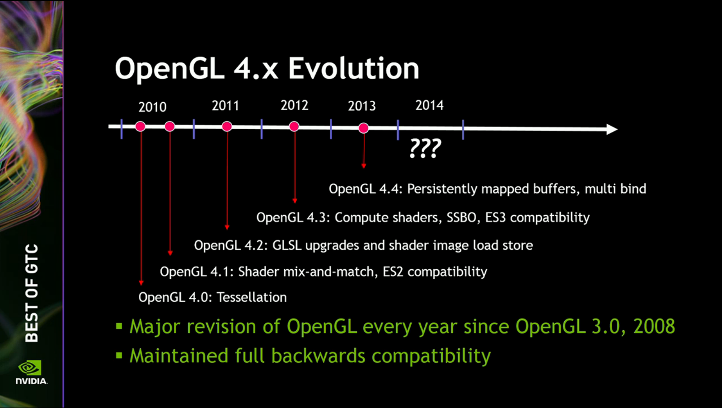
Aug. 2014: 4.5 added DX11 extensions (and many alternative calls)
July, 2017: 4.6 added SPIR-V (what Vulkan uses)

